Slide 1
Horizontal Support and Resistance Levels
By @CryptoCred

Slide 2
Disclaimer
Neither this presentation, nor anything on my Twitter, Telegram, or any other medium/mode of communication, including private correspondence, constitute financial advice. I am not a financial advisor and hold no formal qualifications in this area. Trade entirely at your own risk. This is for entertainment purposes only.

Slide 3
Shoutout
@Trader_Dante
@trader1sz
@WMD4X

Slide 4
Outline
General Remarks
TradingView Setup
Types of Levels
3 Key Principles
Strong Level Criteria + Drawing Tip
Trading the Inverse
Types of Retests
Time Frames
Conclusion

Slide 5
General Remarks
The overwhelming majority of systems or techniques that marketers will try to sell you are some variation of support/resistance (“S/R”)
More an art than a science when it comes to drawing levels
Don’t try to force levels where they’re not clear - highest probability setups will come from clear setups that are worth waiting for
As straightforward as the key principles are, there’s still a lot of common confusion - even experienced traders may learn something new

Slide 6
TradingView Setup

Slide 7
Types of Levels

Slide 8
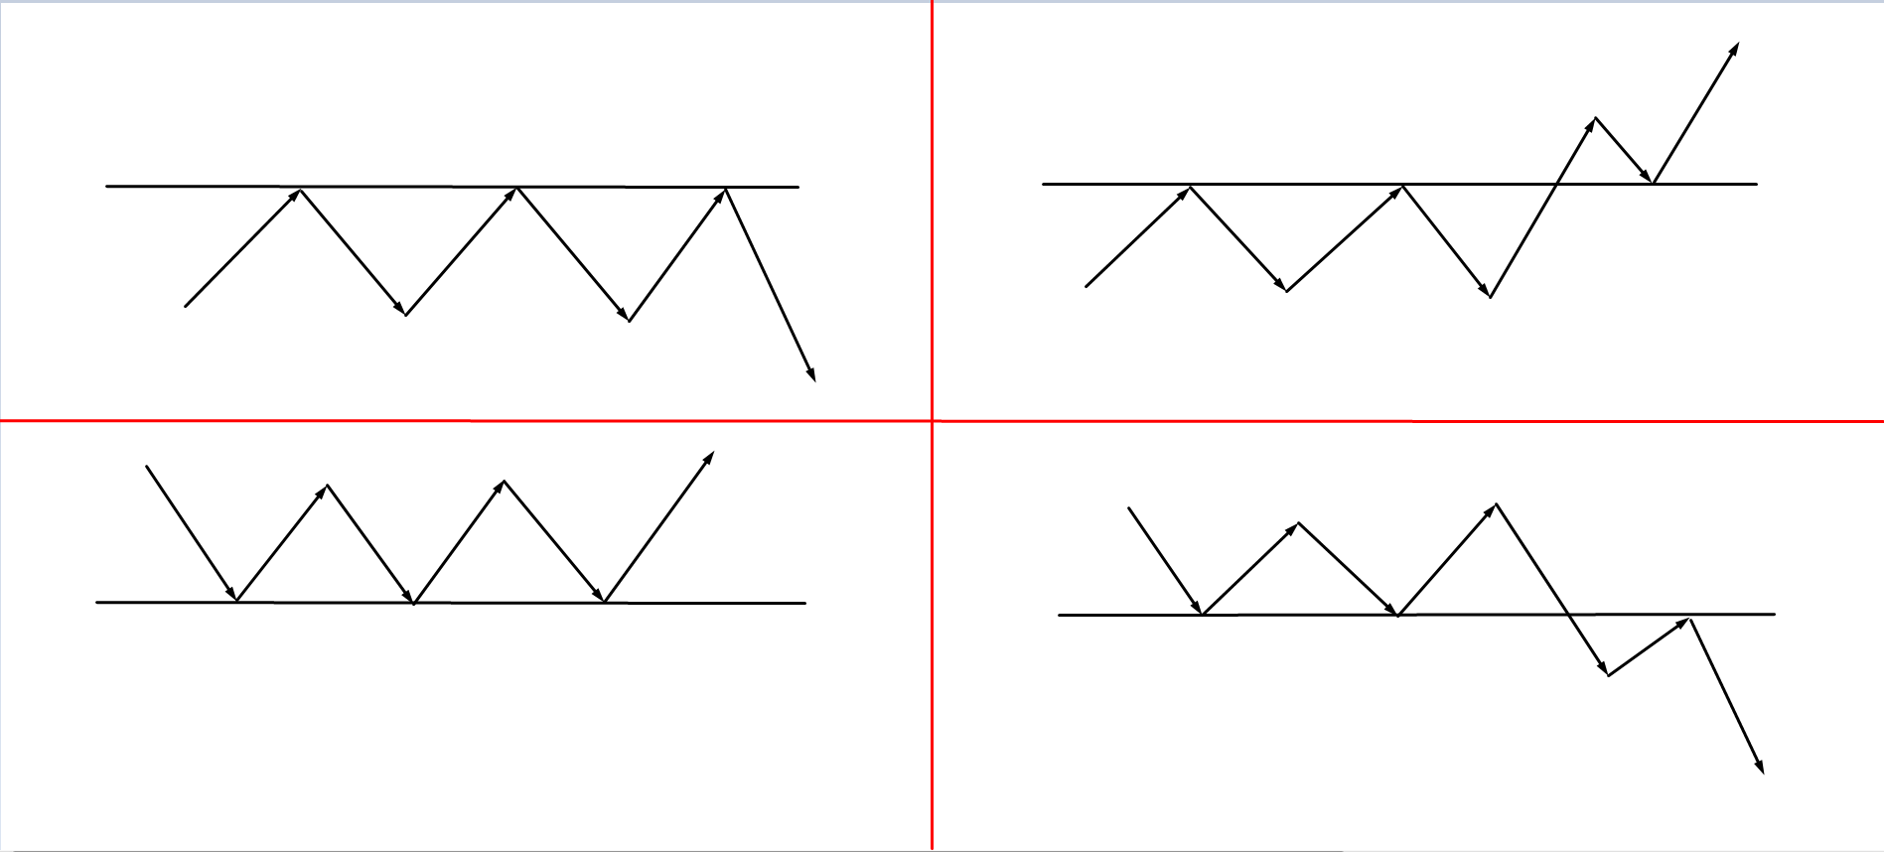

Slide 9
Principle 1 - S/R Flips
Principle: S/R levels flip when broken by price
A support level that is broken turns to resistance
A resistance level that is broken turns to support
Broken: a clean candle close through the level
This basic principle is the backbone of most price action trading concepts

Slide 10
Principle 2 - Recurring Tests
Principle: the more a level is tested by price from the same direction, the weaker it becomes
A support level that is tested repeatedly as support becomes weaker with each test as buyers are absorbed each time
A resistance level that is tested repeatedly as resistance becomes weaker with each test as sellers are absorbed each time
While a level that is tested by price many times from the same direction is weaker with each test, it becomes strong if/when it flips

Slide 11
Principle 3 - First Test Best Test
Logical corollary of Principle 2: the highest probability level trade is the first test of a broken level from the other side
Meaning:
First test of a broken resistance level (expected support)
First test of a broken support level (expected resistance)
Given that the probability of a level holding decreases with each test, one’s odds are enhanced (™) when price tests an S/R flip for the first time; before any buyers/sellers have been absorbed
Any subsequent tests are lower probability, but can still be taken if your trading rules permit it e.g. if there is confluence of some sort

Slide 13
Strong Level Criteria
High number of touches (once the level has been broken)
More touches from the same direction = weaker level as buyers/sellers absorbed
But once the level is broken and price is on the other side, it is fresh
Violent touches (once the level has been broken)
Violence = how strongly price reacted upon testing the level
More violence i.e. bigger swings away = better
Based on recent price action
Extremely important so you don’t use levels that were good in the past but have now been washed
Read the chart from right to left
Interested in what recent market participants are doing
Long duration (once the level has been broken)
Levels that were respected as S/R for longer tend to be stronger
E.g. level that was resistance for several weeks is likely to be a stronger support (when broken) than a level that was resistance for only a few hours
Drawing tip: refine your level by making sure it is hinged on the most recent lows before break downwards/most recent highs before break upwards

Slide 14
Trading the Inverse
Recap:
The more a level is tested from the same direction, the weaker it becomes with each test
S/R levels flip
When an S/R level flips, the first test from the opposite direction is a high probability setup
I.e. first touch of price returning to a broken resistance level (expected support)
I.e. first touch of price returning to a broken support level (expected resistance)
Thus when looking for high probability levels in markets, ask yourself:
Are there any broken support levels above current price? → for shorts
Are there any broken resistance levels below current price? → for longs
Trading the inverse = buying broken resistance & selling broken support

Slide 15
Types of Retests
I trade two types of retests:
Micro retests
Usually seen & traded on lower time frames (5M, 15M and 1H for me personally)
Occur virtually immediately after a level is broken
Sometimes the pullback doesn’t come back and tag the level itself
Lower probability - no higher time frame proof that level has been broken
Rounded retests
Visible on higher time frames as well
Occur where there has been time and space between the break and the retest of the level
Higher probability - higher time frame proof that the level has been broken
Down to your personal preference, risk appetite, and trading journal notes!

Slide 16
Time Frames
Generally, higher time frame levels are more reliable than lower time frame levels
However, the frequency of setups will be considerably reduced if you only trade clean D1 and above levels - they don’t form as often
My personal preference: most of my levels trades are on the H1 and D1 time frames
Find a time frame that i) works for you ii) gives you a good balance between setup frequency and setup quality

Slide 17
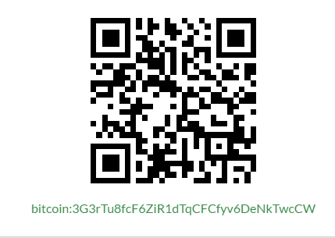
Conclusion
Understanding S/R and S/R flips will makes most concepts much easier to learn and understand
Don’t forget that testing a price structure from the same direction repeatedly makes it weaker, it only becomes strong when/if it is broken
Easy to add tools to confluence this method e.g. Fibs, indicators, other price action structures, et cetera
--
Thanks for watching!
Consider leaving a $BTC tip if you enjoyed the lesson.
3G3rTu8fcF6ZiR1dTqCFCfyv6DeNkTwcCW

